Slide 1

Rubber ducky workshop
Summer of Code 2021

Slide 2
Workshop Overview
Equipment
Computer
HID injector (pick one)
WHID Cactus
Bash Bunny
Hack5 Rubberducky
Arduino BadUsb
Duration
~1h
Goal(s)
Increase security awareness
Have fun
Participants will be ambassadors for why you should not trust USB-devices

Slide 3
Intro
1

Slide 4

PRESENTERS NAME
Position at Capgemini
How long have you been with Capgemini
And other
Facts
About you professionally

Slide 5


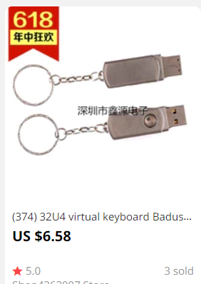


Human interface device (HID)
“A human interface device or HID is a type of computer device usually used by humans that takes input from humans and gives output to humans.” - Wikipedia
Computers tends to trust input devices
Executes payloads under the same privilege as logged in user
No DMZ
No Firewall
No need for zero-days
Inexpensive

Slide 6
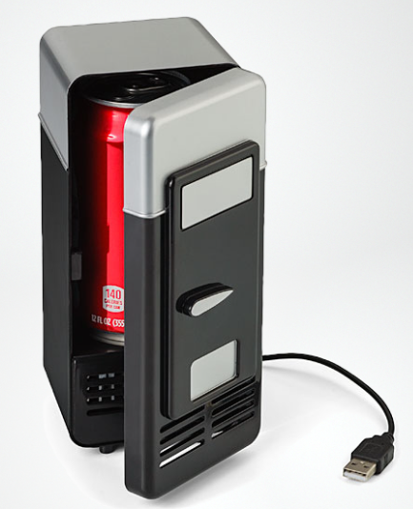
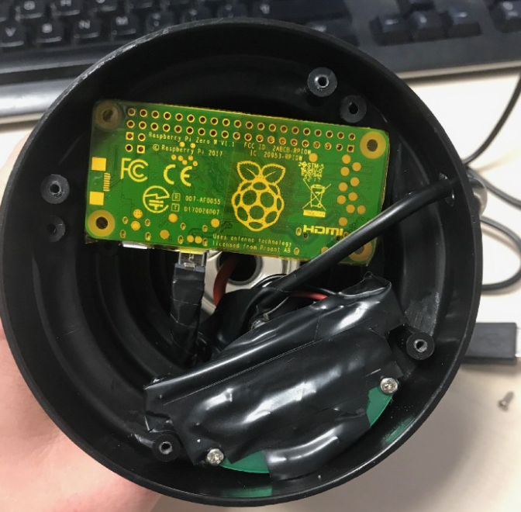
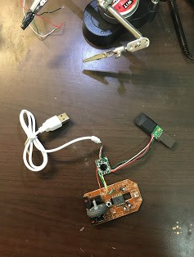
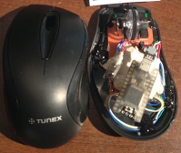
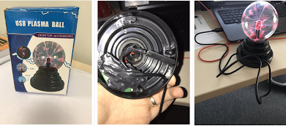
Weaponizing usb gadgets
https://lucabongiorni.medium.com/whid-injector-how-to-bring-hid-attacks-to-the-next-level-b06a40b7df22
https://lucabongiorni.medium.com/weaponizing-usb-gadgets-with-hid-devices-the-revenge-of-p4wnp1-a5615e909677

Slide 7
Ducky script
“Commands are written in ALL CAPS, because ducks are loud and like to quack with pride.”
Ex
REM
Comment
DEFAULT_DELAY / DEFAULTDELAY
Default delay to wait between commands
DELAY
Custom delay to wait before next command
STRING
Type a string
WINDOWS / GUI
Windows-key
DOWN, LEFT, RIGHT, UP
Arrow-keys
REPEAT n
Repeat previous command x times
CAPSLOCK, DELETE, END, INSERT, NUMLOCK, PAGEUP etc.
GUI r
DELAY 50
STRING notepad.exe
ENTER
DELAY 100
STRING Hello World
ALT f
STRING s
REM alt-f pulls up the File menu and s saves. This two keystroke combo is why ALT is jealous of CONTROL's leetness and CTRL+S

Slide 8
Workshop
2

Slide 9
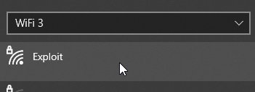
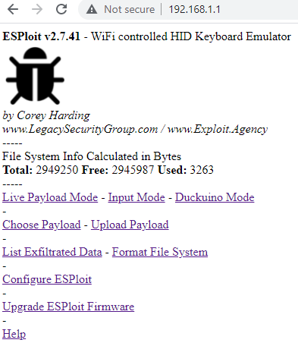
Setup
Insert provided USB-device
Connect to your device through WiFi
Your SSID is “Exploit X” where X is the character written on your device
Password: DotAgency
Open a browser and navigate to 192.168.1.1
Credentials for configuring device is admin/hacktheplanet

Slide 10
Keyboard layout mismatch - workaround
The surefire, somewhat invasive way
REM Swap keyboard-layout GUI r STRING PowerShell Set/WinUserLanguageList /LanguageList en/US, nb /Force ENTER | REM Swap keyboard-layout GUI r STRING PowerShell Set-WinUserLanguageList -LanguageList nb, en-US -Force ENTER
The win-space way
REM Swap keyboard-layout GUI SPACE
The ‘before executing a script’ way
REM Open powershell GUI r STRING powershell ENTER STRING PowerShell Set/WinUserLanguageList /LanguageList en/US, nb /Force ENTER

Slide 11
Free-play
Some resources
https://ducktoolkit.com/userscripts
https://github.com/hak5darren/USB-Rubber-Ducky/wiki/Payloads
https://github.com/whid-injector/WHID/tree/master/Payloads/windows
Google “rubberducky payload”, “duckyscrip payload” etc.

